Slide 1
Can I Get there?
Analysis of 2013 NYC Flight Data
Ben Schmidt, James Rullo, Kshitij Bhat, Srilatha Lakka, Sam SR

Slide 2
Overview
Background of Dataset
Exploration
Background Research
SMART Question Development
Epicycles of Analysis (before & after research)
Methodology
Correlation
Tools
Conclusion

Slide 3
Overview of Dataset
Collected Flight data from 2013 for New York City Airports (departing JFK, LGA, EWR)
Sample: Inclusive of entire dataset
Source: Built-in package - nycflights13
R Package: nycflights13
Dataset gathered to provide exploratory data for various applications.

Slide 4
Exploration
How often do flights get delayed?
Which carrier’s have delay’s more often?
What percentage of flights get delayed each month?

Slide 5
Background Research
Flight delays cost $32.9 Billion with passengers paying half the cost.
Flight delays are linked to multiple aspects of a flight details, like , carrier, destination, time of year, and weather.
Below details related to departure delay, can give insight to the passengers:
The correlation between departure delay to other aspects of the flight details
The ranges of delays by different carriers
The delays probability during different times of the year

Slide 6
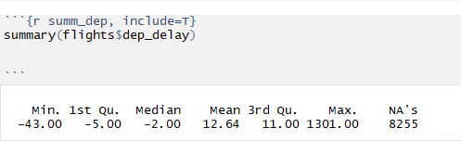
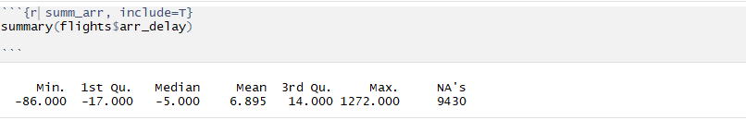
Summary
The 5 number summary of the departure delay of the dataset.
We can observe that minimum and 1st Quartile is in negative values showing earlier departures
The 5 number summary of the arrival delay details of the flights dataset.
The minimum and 1st quartiles being negative values show earlier arrivals than the scheduled time

Slide 7
SMART Question Development
Compare the delays by different carriers to see which carriers have the least delay to make their efficiency of air transport. Considering only the timely departure and arrival, and ignoring the other aspects of air travel.
Are there flights which often depart earlier than the scheduled time? If yes, do they have early arrival too?
Does departure delay can be used to predict the arrival delay?
Do particular carriers have expected delays more often? Analysis can be used to inform the passengers to avoid flights of such carriers in case of urgent travel.

Slide 8
Epicycles of Analysis (before & after research)
Sought to understand features of the data
Narrowed dataset to remove empty rows and outliers
Identified critical features of the data

Slide 9
Methodology
EDA
A delay is defined as any flight which arrives at the gate at least 20 min later than the scheduled arrival time.
We ignored data with NA value in the data and the flight data which has less than 20 minutes of delay.
The maximum delay in flights for the year 2013 was 1301 minutes

Slide 10
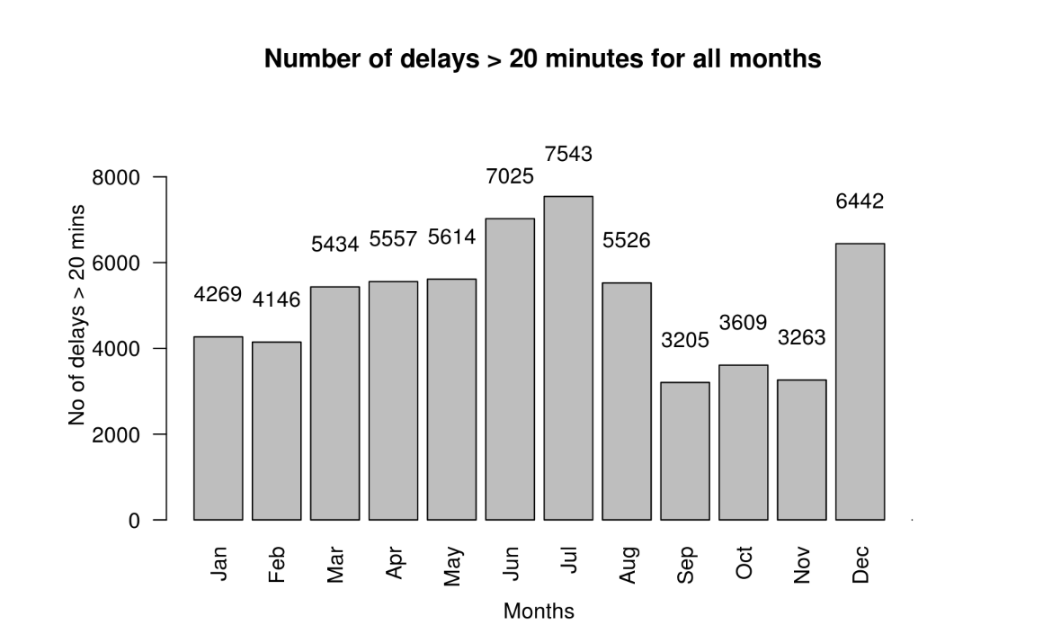
Correlation/Results
From below screen shot we can predict that June, July and December months have the most number of delays.

Slide 11
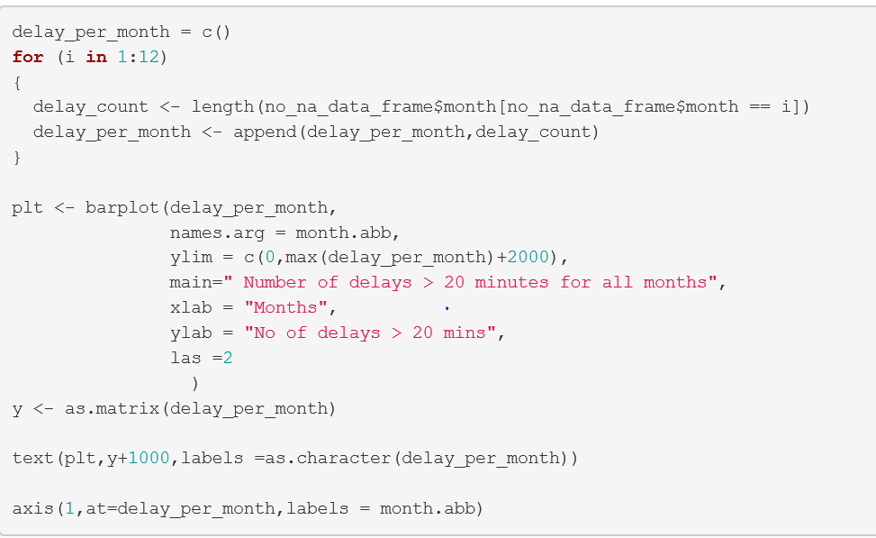
R Markdown code

Slide 12
Results
Following is the observation for the flights that departed from New York city
Approx 1/4th of the number of flights by ExpressJet Airlines have a delay greater than 20 mins
Approx 1/5th of the number of flights by Jetblue Airways have delay greater than 20 mins
Approx 1/6th of the number of flights by United Airlines have delay greater than 20 mins

Slide 13
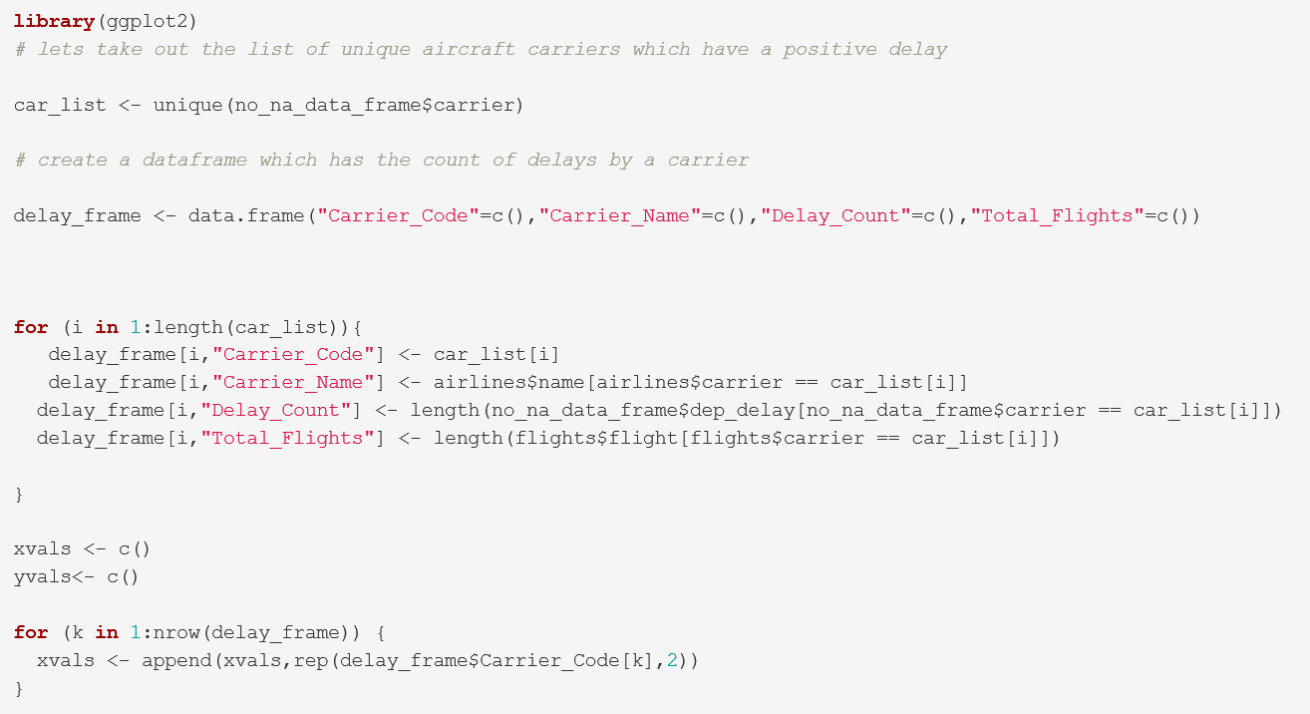
R Markdown Code

Slide 14
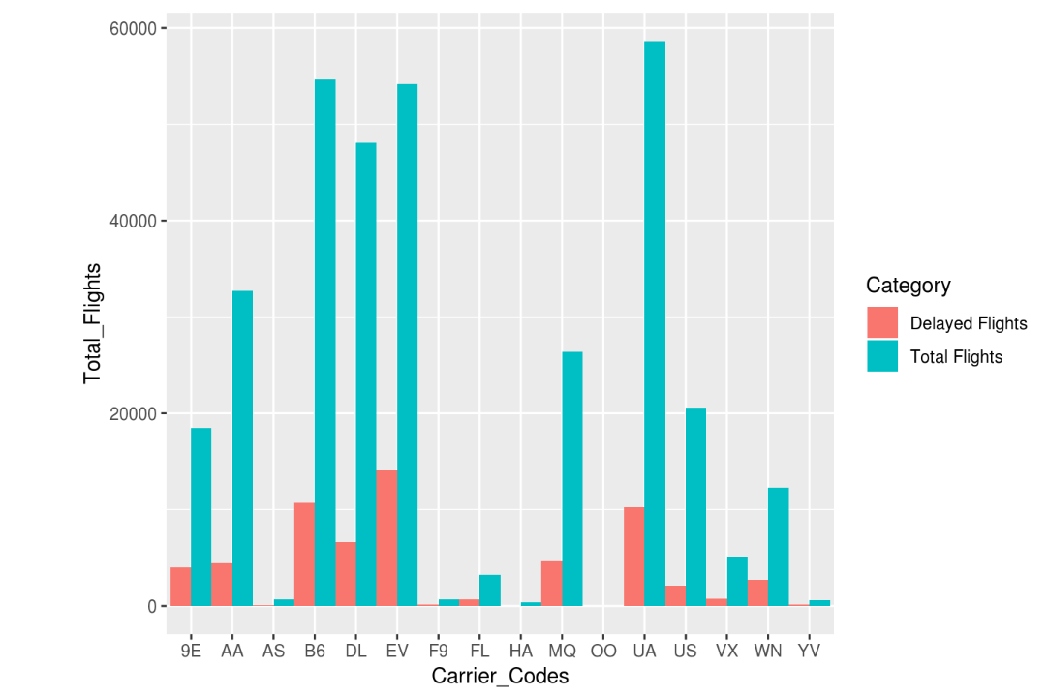
Delays by Carriers

Slide 15
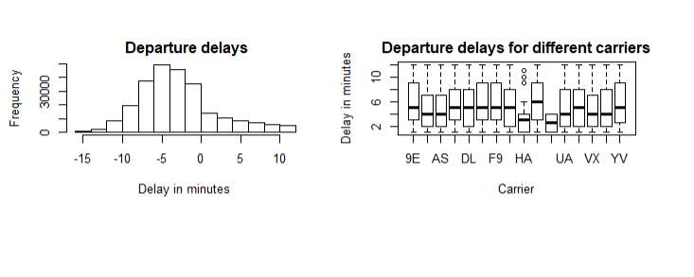
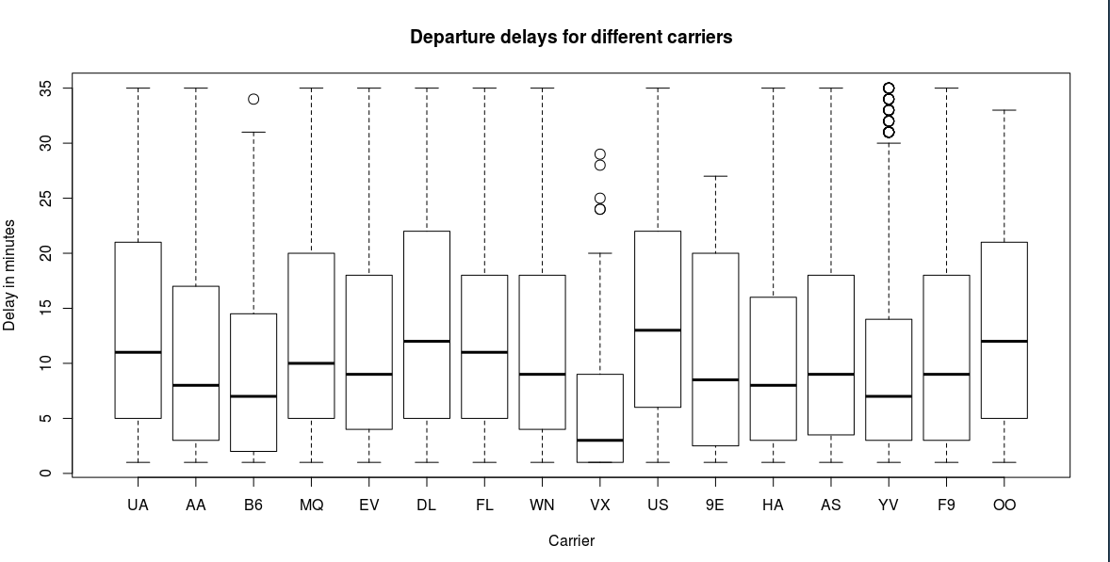
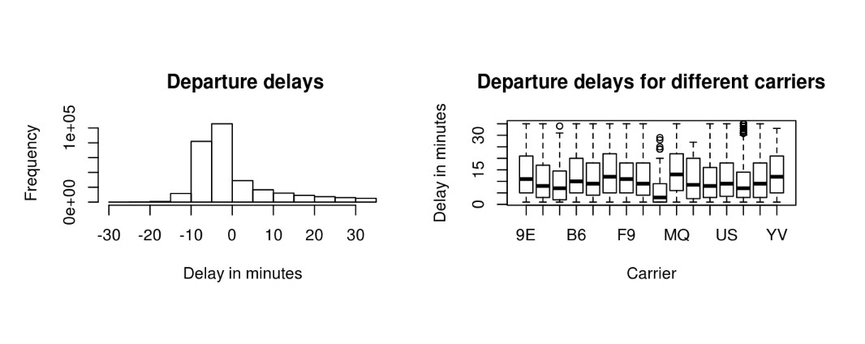
Delays by Carriers

Slide 16
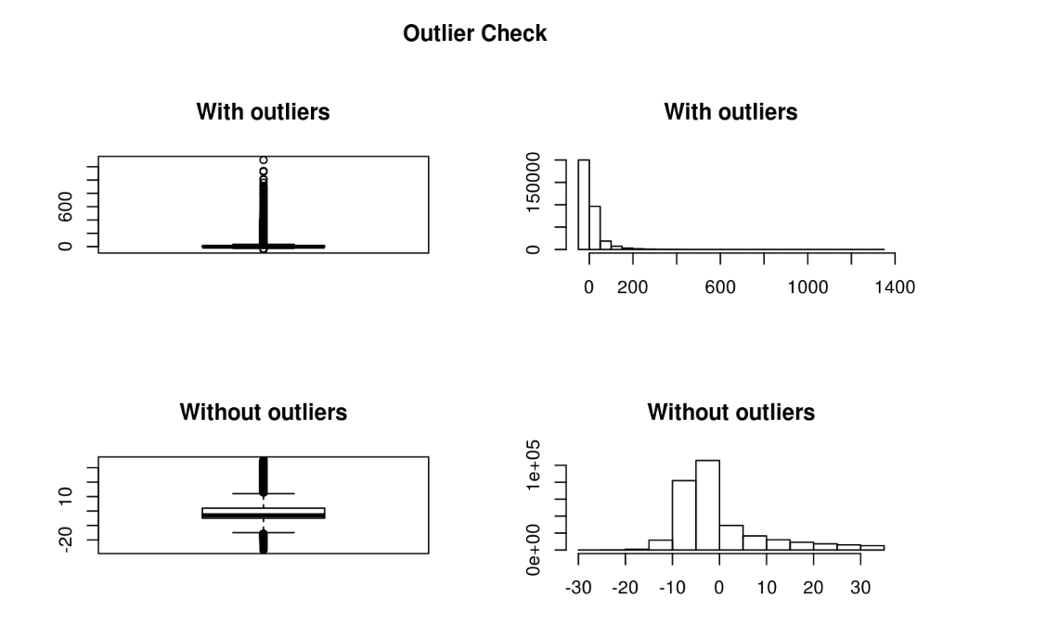
Handling the NA values and Outliers

Slide 17
Observation on above Outlier check
We can see that there are multiple occasions where the flights have departed earlier than the scheduled time with delay being negative in value.

Slide 18
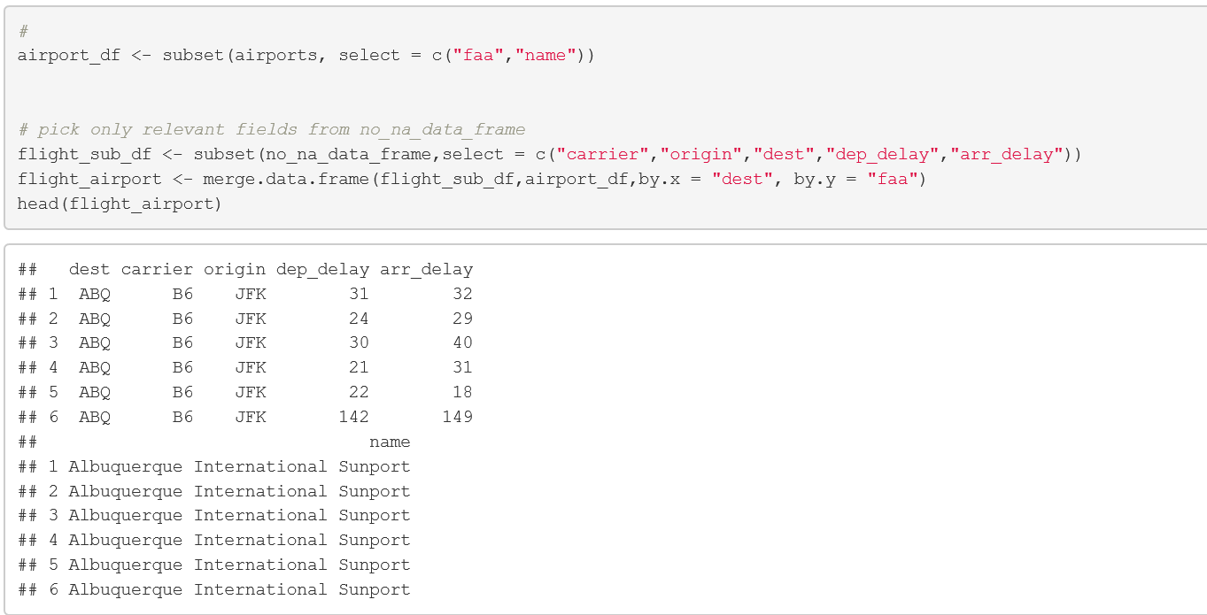
Are delays common for a particular origin and destination airports?

Slide 19
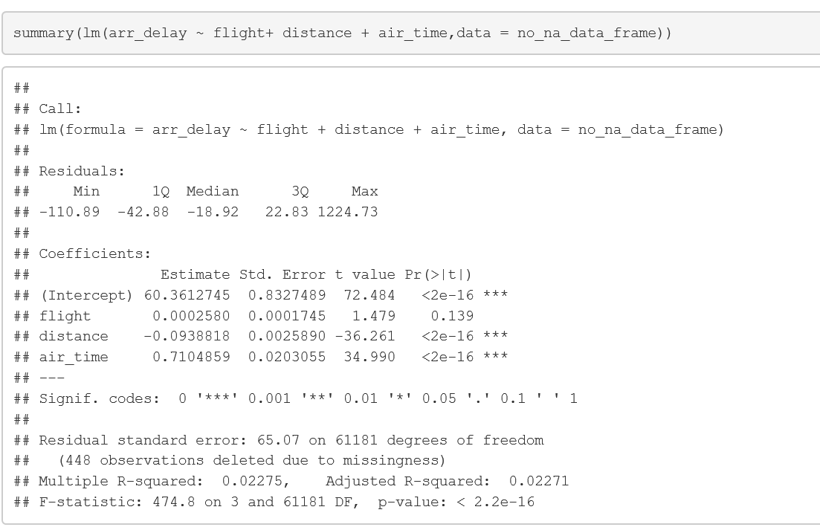
Linear Models:
Correlation between flight arrival/delays

Slide 20
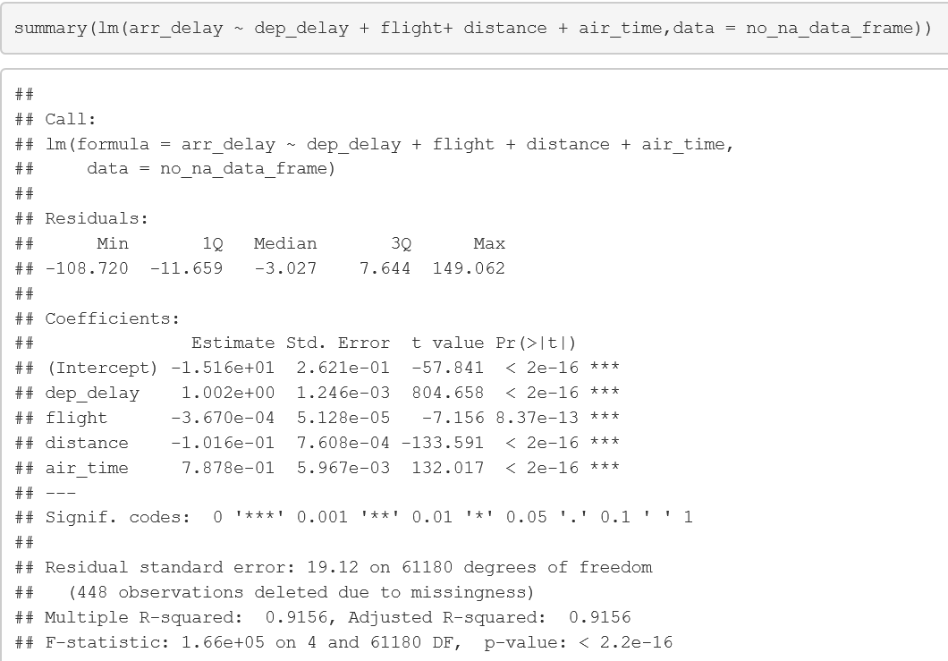
Linear Models:
Correlation between flight arrival/delays

Slide 21
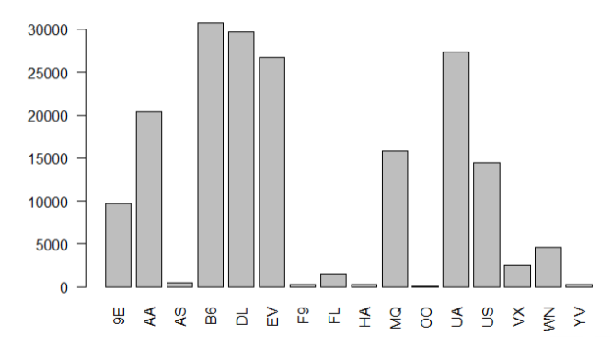
Which airlines depart earlier than the scheduled time more often?
This first graph represents all flights for which the actual departure time was earlier than the scheduled departure time, separated by carrier.

Slide 22
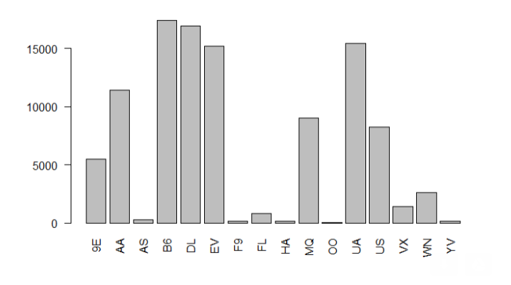
This graph represents that all flights for which both the actual departure time was earlier than the scheduled departure time, AND the actual arrival time was earlier than the scheduled arrival time, separated by carrier.
Note the graphs are virtually identical in terms of the relative proportions of the number of flights between carriers, but that the magnitude of number of flights has been about halved. This suggests that carriers don't have a big impact on early flights arriving late.
`

Slide 23
Tools
Flights 2013 Data
Barplot
Boxplot
Ggplot2
Linear Modeling
T testing

Slide 24


Conclusions
Flight delays may increase costs to customers and operational costs to airlines
We found that major delays are happened during the month of June/July and December.
Flying is not fun. And you will be late. And sad. And hungry.

Slide 25
Areas for Further Study
Pulling in additional sources of data to compare with the flight arrival database would likely produce a better quality predictor model for flight delays. Specifically, we believe that the following sources of data would be helpful in building a robust flight delay model:
Differentiating the delays between long distance and short distance flights
Binding the weather details with airports and the flights
Binding the aircraft details with flight delays

Slide 26
QUESTIONS?

